Slide 1


Slide 2
"Self-perception of high expertise increases closed-mindedness."
- Victor Ottatia, Loyola University
(AKA: I already know it all)

Slide 3
You Are The Expert
You are already good at what you do, now let’s help you get more out of the time you already spend on your teams.

Slide 4
Where DOES My Data Come From?
Primary Sources
Your information about your current athletes.
Secondary Sources
Other peoples information about your athletes.
Your information about your past athletes.
Other Sources
Databases, videos, historical information, other coaches.

Slide 5
Primary Data Sources
Your information about your current athlete.
Historical data.
Goal data.
Practice data.
Strength training data.
Performance vs. conditions.

Slide 6

“If we put a watch on it, we write it down.”
Coach Scott

Slide 7
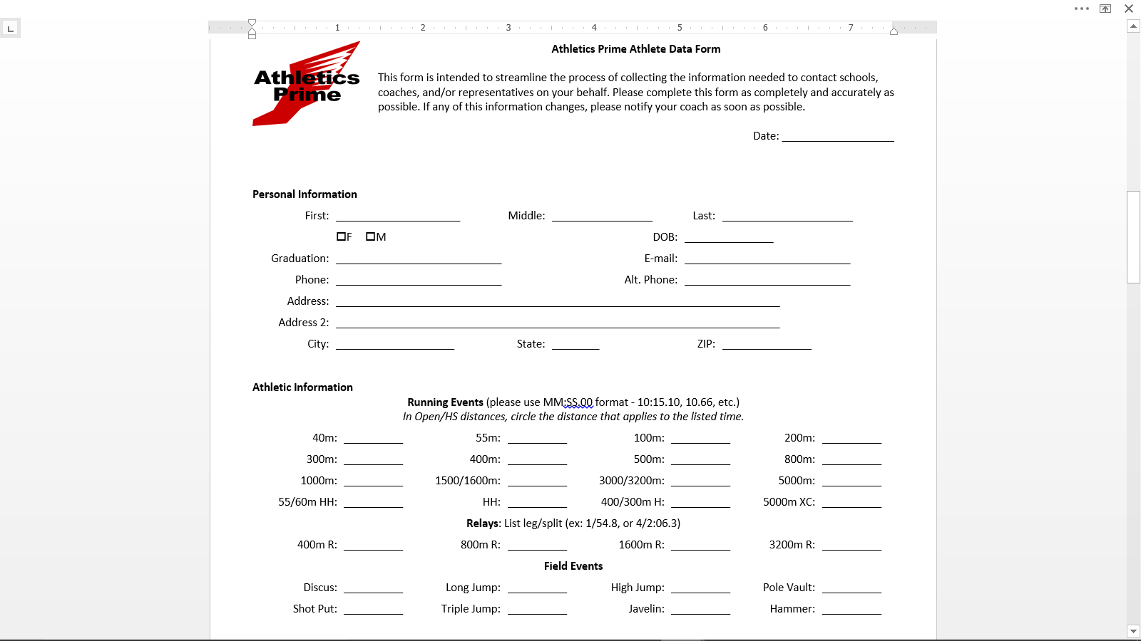
Athlete Data Form (pre-season)

Slide 8
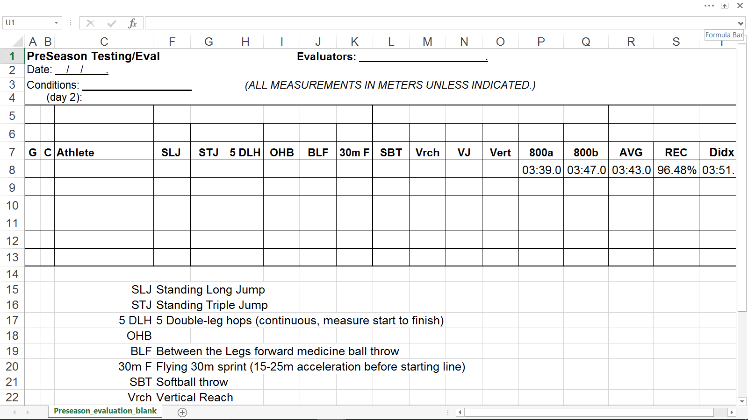
PreSeason Testing and Evaluation

Slide 9
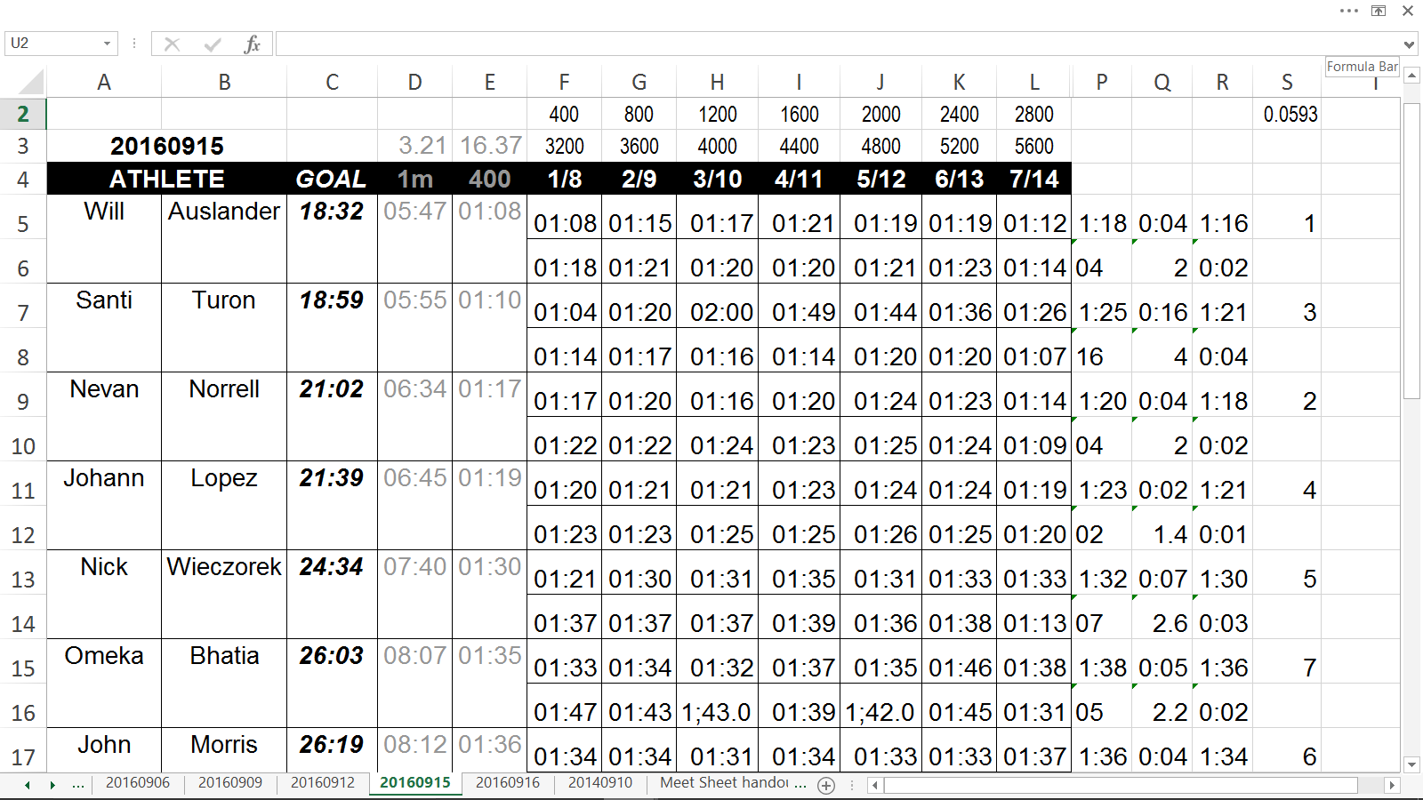
Practice Session Data

Slide 10
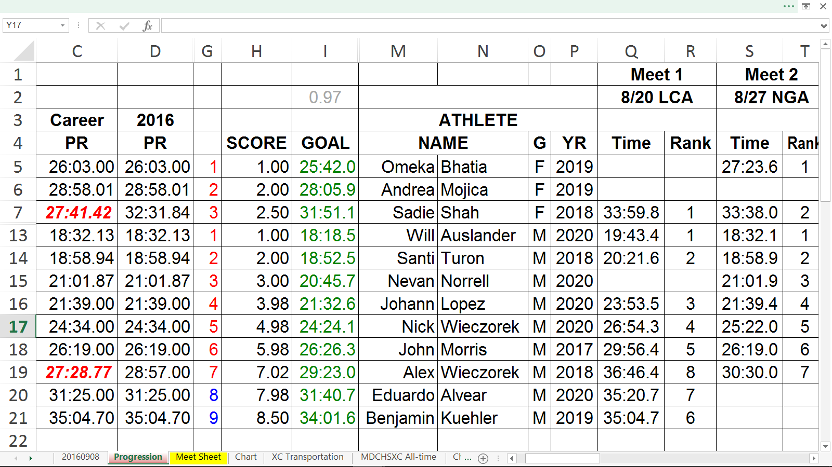
Competition Data (including predictive targets)

Slide 11
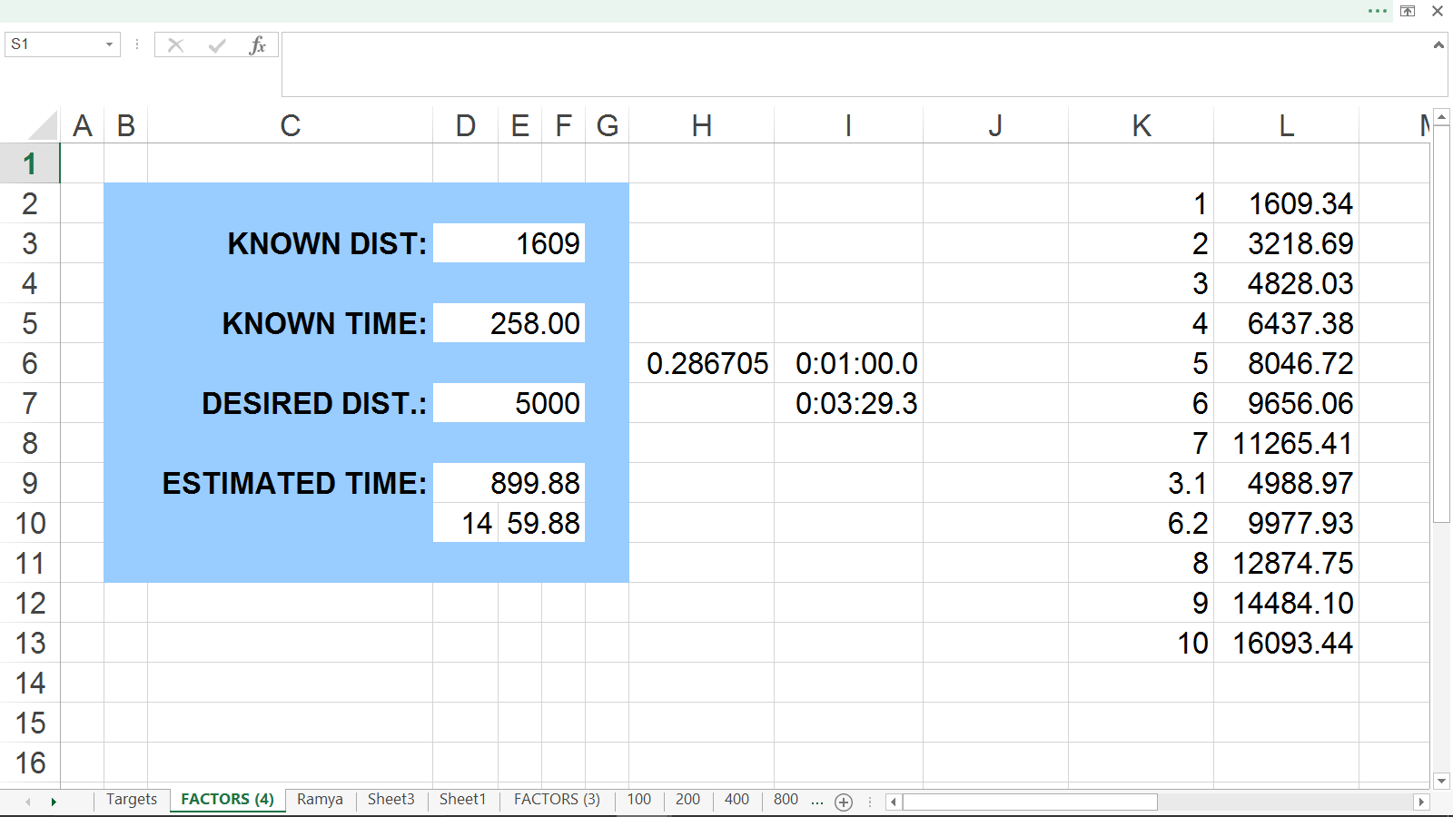
“Distance Factors” Spreadsheet (conversions)

Slide 12
Secondary Data Sources
Other peoples information about your athletes.
Recovered data: splits, conditions, opponents.
Observation and commentary from coaches.
Your information about your past athletes.
Historical data

Slide 13
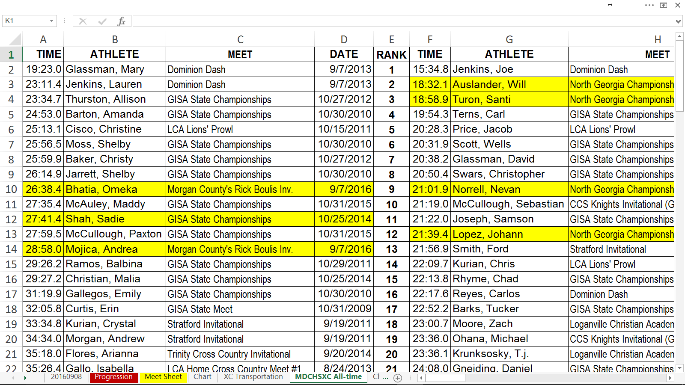
Program Historical Data (All-Time List)

Slide 14
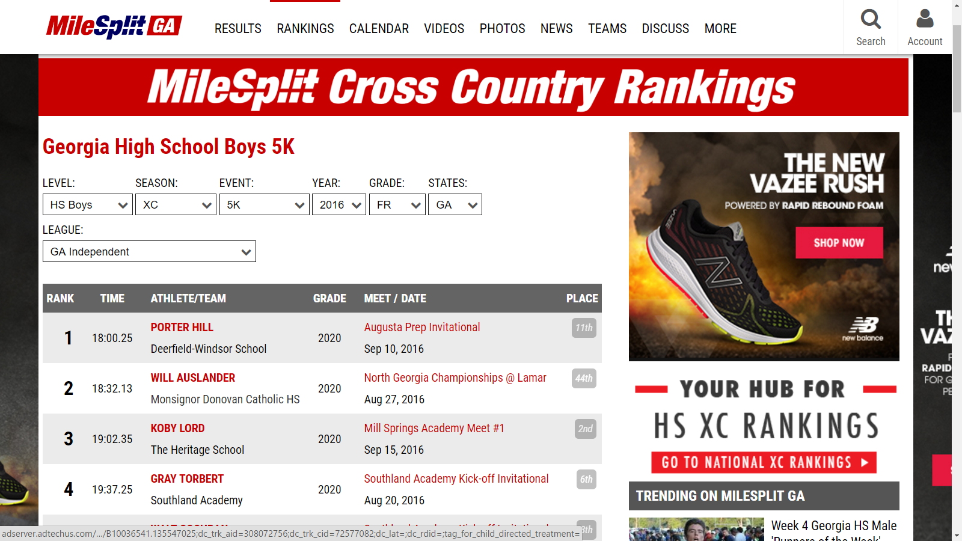
Ranking Data and/or Course Comparison

Slide 15
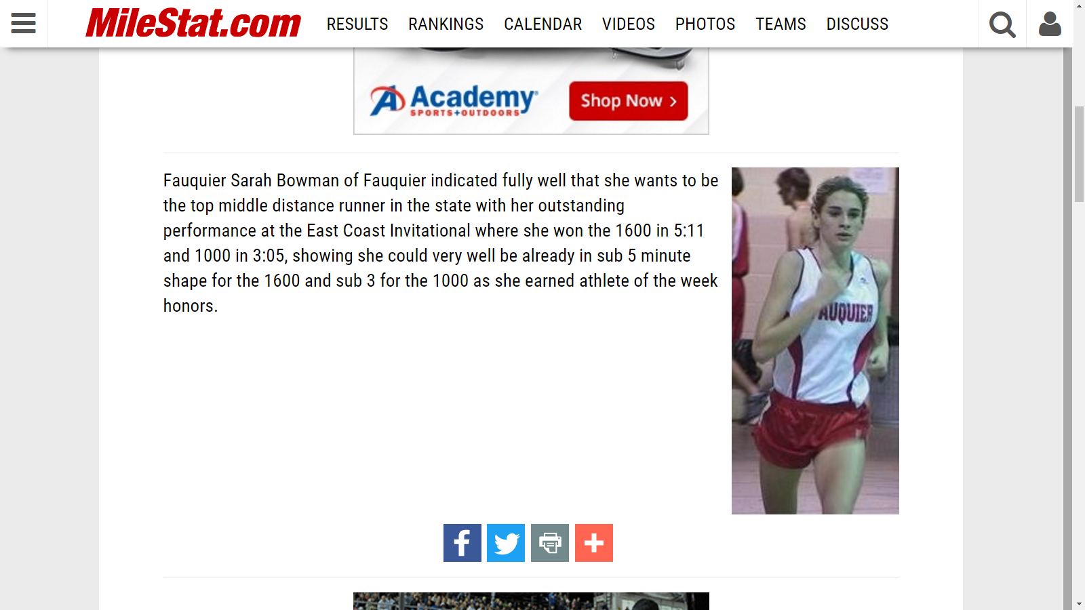
Personal Observations by Others

Slide 16
Other Data Sources
Databases, videos, historical information, other coaches.
Information about past competitions in venues you will compete in.
Supporting or complementary numbers (we all miss something - go fill in the blanks).

Slide 17
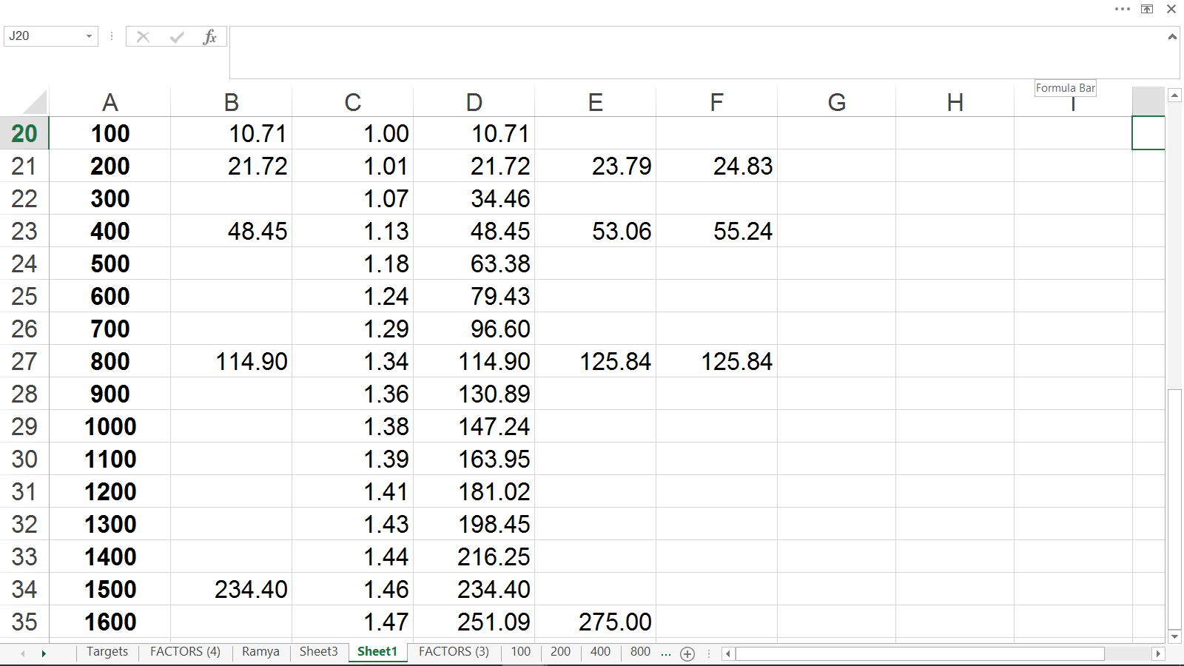
Elite Performance Averaging (event data)

Slide 18
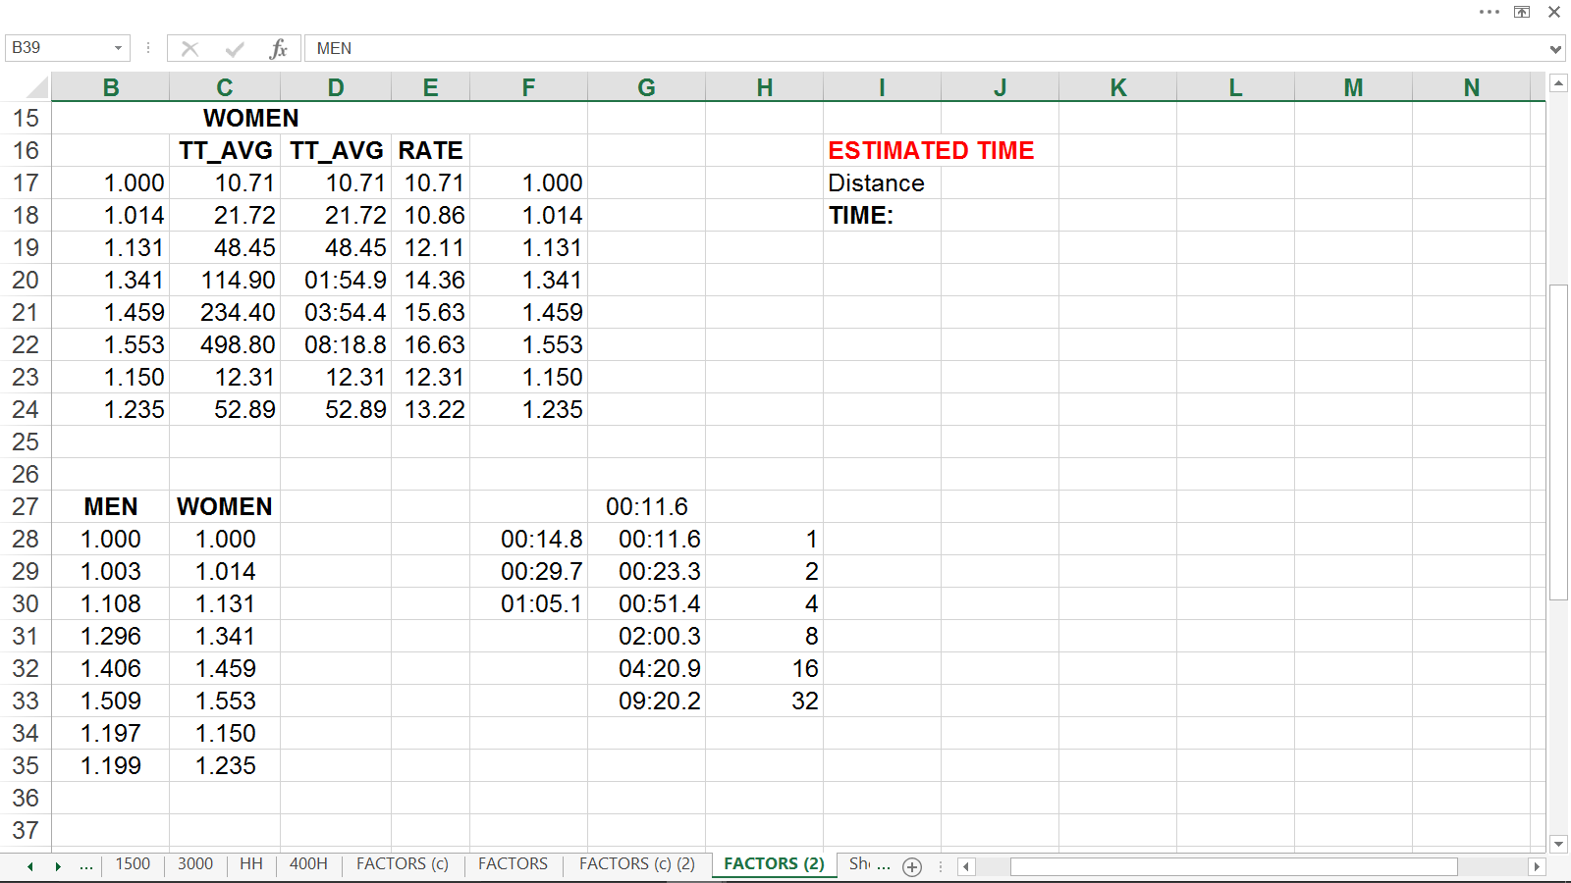
Elite Performance Averaging (gender neutralizing)

Slide 19
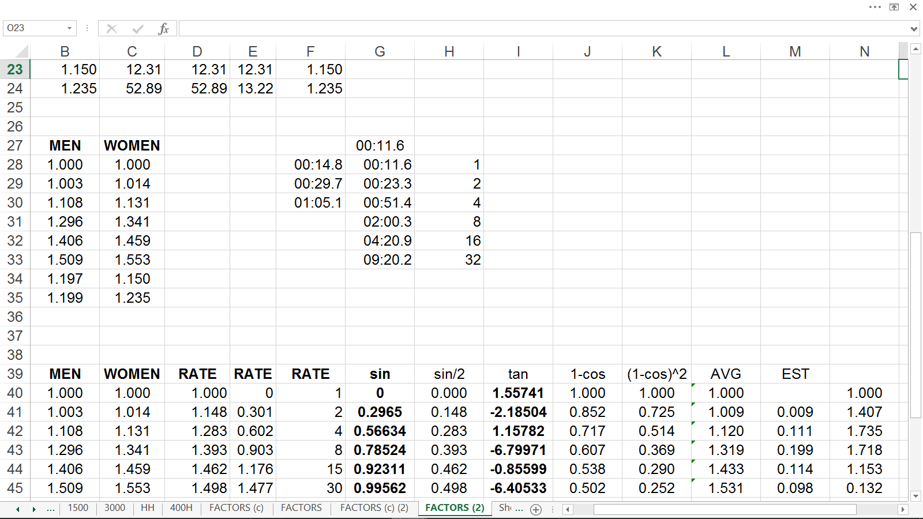
Elite Performance Averaging (formula building)

Slide 20
Where DOES My Data Come From?
Primary Sources
Your practice sessions.
Secondary Sources
Other peoples information about your athletes.
Your information about your past athletes.
Other Sources
Databases, videos, historical information, other coaches.

Slide 21
You Are The Expert
You are already good at what you do, now be courageous enough to become even better.

Slide 22


